Slide 1
The Ethical Implications of using Artificial Intelligence in Auditing
Helen Brown-Liburd
Miklos Vasarhelyi
Presented by: Ivy Munoko

Slide 2
Overview
Why consider ethics in Artificial Intelligence use?
Current use of AI in accounting / auditing
Ethical frameworks used to assess AI
Ethical implications for auditing
Way forward

Slide 3
Why consider ethics in Artificial Intelligence?
The increased use of automation and artificial intelligence (AI) in auditing will result in a shift in the auditor’s roles and level of involvement in the audit, but not the auditor’s responsibility.
“30% of corporate audits [will be] performed by AI” by 2025 - World Economic Forum survey of 800 executives and experts
There are benefits:
AI promises the capability to review unstructured data real-time and provide a concise analysis of numerical, textual and visual data.
However, there are unintended consequences which are the focus of the study
Notes:
a scenario where a bank implements AI in the mortgage application approval process and discover that the AI algorithm makes biased recommendations even though AI was adopted by the bank to prevent bias in the mortgage approval process.
Data privacy concerns, such as the protection against client’s data repurposing and spillovers
The result of a massive rollout of the automated intelligent agents in place of the professional in an accounting and auditing environment and the resultant effect on audit quality is undetermined.

Slide 4
Artificial Intelligence
Data
Algorithms
Data is used to identify patterns and develop models for predictive tasks
Use
Throughout its use, AI updates its models based on new data it is exposed to
Real world data is continuously fed into AI
Examples of ‘What could go wrong’ with AI systems
1. Data collection and usage by AI leads to privacy / security violations? 2. Data inaccuracy? Therefore algorithm inaccuracy? 3. Biased data / data that does not represent the true population result in unfair / incorrect decisions made by algorithms? | 4. Complex AI models resulting in unexplainable and therefore undefendable decisions? 5. Users of AI relying wholly on the system and not performing reasonableness tests of AI output? 6. Regulations violated by AI use? (e.g. HIPAA)

Slide 5
Is it too early to talk about ethics and AI?
What is the way forward?
No approach (“Let’s not stifle innovation”)
Reactive approach (“Let’s wait and see”)
Proactive approach (“Let’s think about ethics now before it’s too late”)
We suggest a proactive approach
Given that emerging technology grows exponentially fast, the profession will have less time to consider the ethical challenges

Slide 6
Key Research question
Is the fulfilment of the ethical responsibility of the auditor to the shareholders and public impacted by the use of artificial intelligence?
Independence / Confidentiality
Competence and Due Care
Objectivity
Auditor’s mindset and behavioral expectation
Auditors are relying on emerging technology
(characteristics of emerging technology: radical novelty, fast adoption, high impact, uncertainty since not yet mature)

Slide 7
Current AI implementations: All Big 4 accounting firms are reporting the use of these AI blocks
Machine Learning
Classifier ( tax transaction, contract)
Big AI / Smart Analytics
Large scale data analysis
Natural Language Processing
Synthesis of text
Machine Vision
Intelligent RPA
Speech
Recognition
Decode conversation
Chat bots
Digital Assistants
Test of transactions
Document workpapers
GL review
Bank confirmation
OCR + Machine learning to extract data from images
Drones + IoT to perform inventory inspection
e.g. review of contracts, vendor invoices, emails, transcribed conversation
discover facts and relations that are difficult for the human mind
Review full population for outliers
Fraud detection

Slide 8
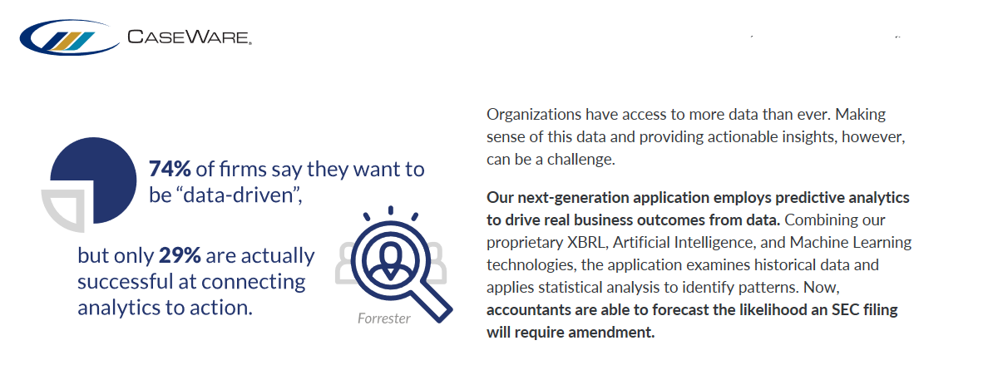
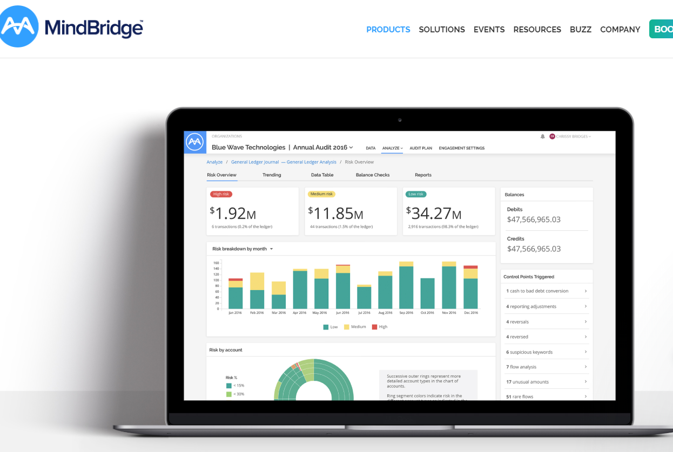
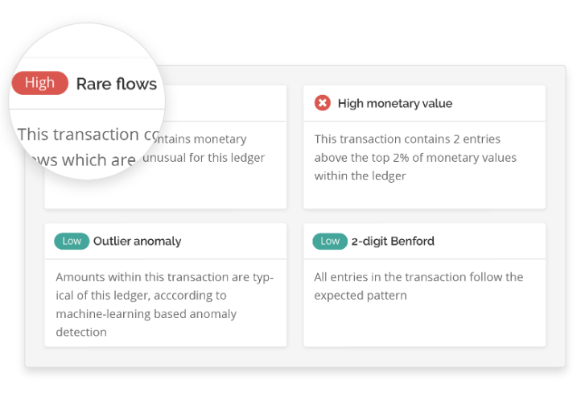
Current implementations: Small / medium size accounting firms are using AI SaaS
Ensemble AI: Combines Machine learning with Domain expertise / business rules and statistical methods to:
-gain actionable insight into large data
-review 100% of data
-sample from outliers
-perform risk assessments

Slide 9
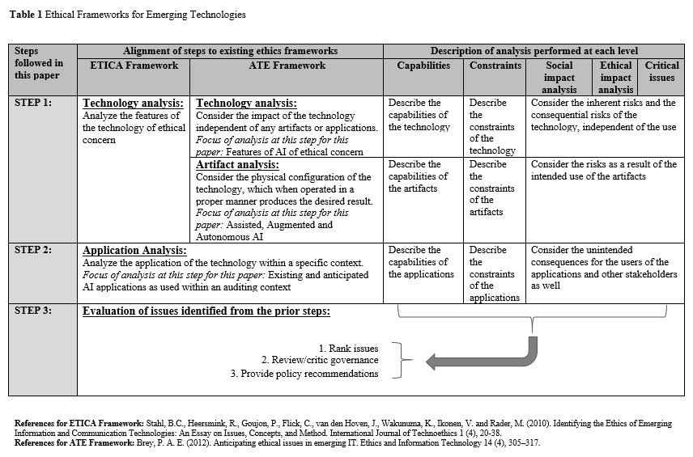
Ethical Frameworks - A futuristic approach

Slide 10
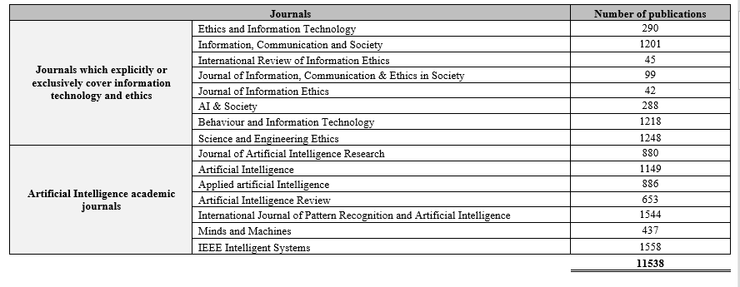
How ethical issues were identified

Slide 11
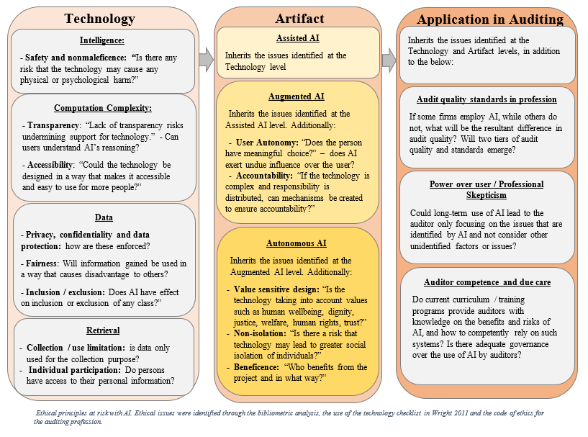
Ethical Issues identified

Slide 12
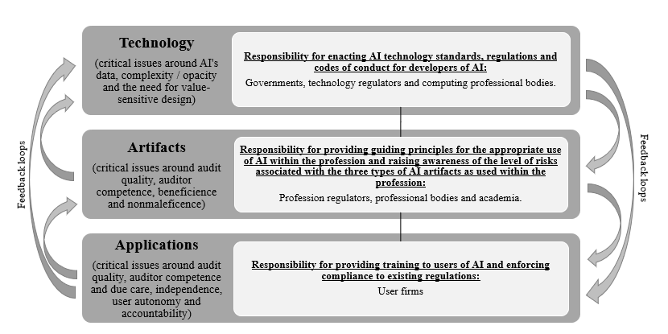
Proposed responsibility mapping

Slide 13
Way forward?
1) Multi disciplinary / stakeholder research initiatives
2) Monitor use and capabilities of AI, ensuring that the expectation of AI does not exceed current capabilities
3) Forecast, Mitigate, Diagnose potential issues (e.g. ethical)
Developers
Ethicists
Academia
Corporations
Professionals
Regulators
Accounting firms
Government

Slide 14
Questions?

